Slide 1
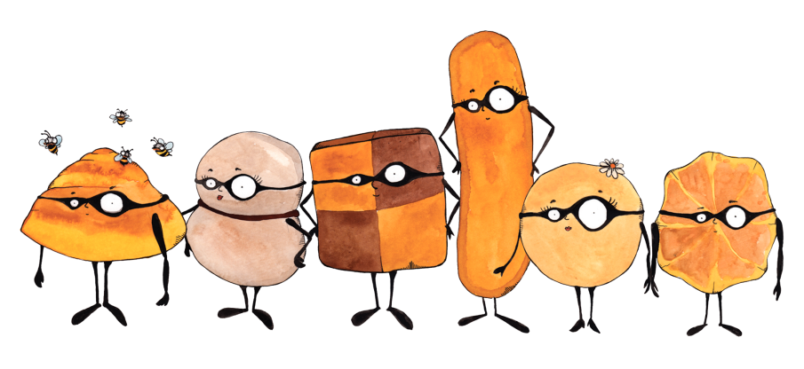
Observation of the
roton mode excitation
in a dipolar
Bose-Einstein condensate
11th PhD Di ssertation
e
Department of Physics and Astronomy
University of Florence
Giulia Faraoni
Sesto Fiorentino, July 20th 2017

Slide 2
Outline
Introduction
What is a roton ? …A look to superfluid helium
Bose-Einstein condensates (BECs) and dipolar BECs
Roton physics in dipolar BECs
Observation of the roton mode excitation in a dipolar
Bose-Einstein condensate of Erbium atoms
The Erbium experiment in Innsbruck (Austria)
Experimental results
Comparison to theory
Conclusion and outlooks

Slide 3
Introduction

Slide 4
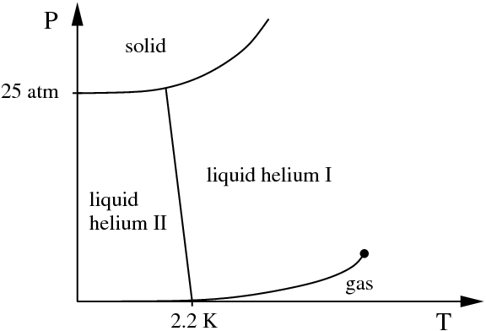
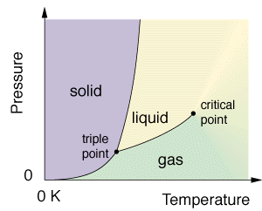
⁴He at T ≈ 0
Special property of Helium (He): when it is cooled down to arbitrarly low temperatures, He remains liquid instead of solidifying, for sufficiently low pressure!
Phase diagram of ⁴He
Phase diagram of all other elements of the periodic table
Critical point
0
0

Slide 5
⁴He at T ≈ 0
Special property of Helium (He): when it is cooled down to arbitrarly low temperatures, He remains liquid instead of solidifying, for sufficiently low pressure!
Phase diagram of ⁴He
Phase diagram of all other elements of the periodic table
Critical point
0
0
1927, Wolfke and Keesom:
II order phase transition
In liquid Helium 4

Slide 6
Superfluid ⁴He
Special property of Helium (He): when it is cooled down to arbitrarly low temperatures, He remains liquid instead of solidifying, for sufficiently low pressure!
Phase diagram of ⁴He
1938, Kapitza (and Allen & Misener):
Experiments on liquid helium II
reveal its extremely low viscosity
Critical point
0
0

Slide 7
Superfluid ⁴He
Special property of Helium (He): when it is cooled down to arbitrarly low temperatures, He remains liquid instead of solidifying, for sufficiently low pressure!
Phase diagram of ⁴He
1938, Kapitza (and Allen & Misener):
Experiments on liquid helium II
reveal its extremely low viscosity
Superfluid
He II is named superfluid
by Kapitza, in connection to electronic superconductivity
in metals
Normal fluid
Critical point
0
0

Slide 8
Superfluid ⁴He
Special property of Helium (He): when it is cooled down to arbitrarly low temperatures, He remains liquid instead of solidifying, for sufficiently low pressure!
Phase diagram of ⁴He
1938, Kapitza (and Allen & Misener):
Experiments on liquid helium II
reveal its extremely low viscosity
Superfluid
He II is named superfluid
by Kapitza, in connection to electronic superconductivity
in metals
Normal fluid
Critical point
0
0
1938, Tisza, Landau:
…other experiments reveal a non-zero viscosity of He II!
Two-fluid model of superfluid ⁴He
Superfluid (zero viscosity) + normal component (finite viscosity)

Slide 9
Superfluid ⁴He
Special property of Helium (He): when it is cooled down to arbitrarly low temperatures, He remains liquid instead of solidifying, for sufficiently low pressure!
Phase diagram of ⁴He
1938, Kapitza (and Allen & Misener):
Experiments on liquid helium II
reveal its extremely low viscosity
Superfluid
He II is named superfluid
by Kapitza, in connection to electronic superconductivity
in metals
Normal fluid
Critical point
0
0
1938, Tisza, Landau:
…other experiments reveal a non-zero viscosity of He II!
Two-fluid model of superfluid ⁴He
Superfluid (zero viscosity) + normal component (finite viscosity)
Excitations!

Slide 10
Elementary excitations in ⁴He
Dispersion relation for a particle = relation between energy and momentum
(For a particle of mass m in free space:$E= \frac{p^{2}}{2m},$
for a photon:$E=pc )$

Slide 11
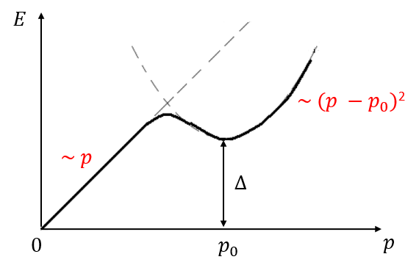
Elementary excitations in ⁴He
Dispersion relation for a particle = relation between energy and momentum
(For a particle of mass m in free space:$E= \frac{p^{2}}{2m},$
for a photon:$E=pc )$
1941, Landau‘s dispersion relation
Two kinds of low-energy elementary excitations in ⁴He:
phonons ($E=pc_{s})$ + rotons ($E= ∆+\frac{\left(p −p_{0}\right)2}{2m}$)
roton
phonon

Slide 12
Elementary excitations in ⁴He
Dispersion relation for a particle = relation between energy and momentum
(For a particle of mass m in free space:$E= \frac{p^{2}}{2m},$
for a photon:$E=pc )$
1941, Landau‘s dispersion relation
Two kinds of low-energy elementary excitations in ⁴He:
phonons ($E=pc_{s})$ + rotons ($E= ∆+\frac{\left(p −p_{0}\right)2}{2m}$)
Originally proposed in order to reproduce experimental results on heat capacity of liquid ⁴He
roton
phonon

Slide 13
Elementary excitations in ⁴He
Dispersion relation for a particle = relation between energy and momentum
(For a particle of mass m in free space:$E= \frac{p^{2}}{2m},$
for a photon:$E=pc )$
1941, Landau‘s dispersion relation
Two kinds of low-energy elementary excitations in ⁴He:
phonons ($E=pc_{s})$ + rotons ($E= ∆+\frac{\left(p −p_{0}\right)2}{2m}$)
1954, Feynman:
relates Landau’s energy
spectrum to the static structure
factor of the liquid
roton
$$p_{0}\sim \frac{1}{d}$$
$d$= mean interparticle distance
phonon
Tendency of the atoms to estabilish a local order, driven by strong interatomic interactions

Slide 14
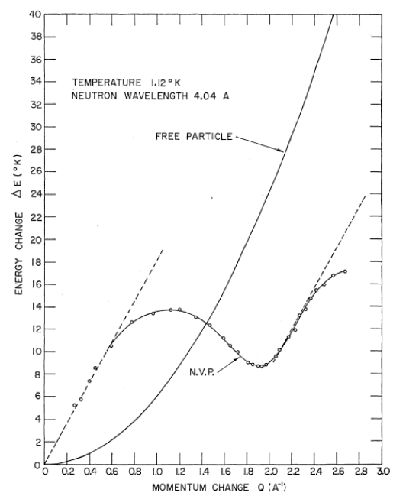
Elementary excitations in ⁴He
Dispersion relation for a particle = relation between energy and momentum
(For a particle of mass m in free space:$E= \frac{p^{2}}{2m},$
for a photon:$E=pc )$
1941, Landau‘s dispersion relation
Two kinds of low-energy elementary excitations in ⁴He:
phonons ($E=pc_{s})$ + rotons ($E= ∆+\frac{\left(p −p_{0}\right)2}{2m}$)
Confirmed by neutron scattering experiments!
(1961, Henshaw and Woods)
roton
phonon

Slide 15
Bose-Einstein condensate (BEC)
A state of matter of a dilute gas of bosons cooled to temperatures close to 0 Kelvin, featuring a macroscopic occupation of the lowest single-particle quantum energy state ( = single-particle ground state)
Decreasing temperature
1924,
Bose, Einstein:
Theory of a
non-interacting
BEC
http://cua.mit.edu/ketterle_group/intro/whatbec/whtisbec.html
1947, Bogoliubov: Theory for weakly-interacting BEC
1995, Cornell & Wiemann, Ketterle: First experimental realizations of a BEC

Slide 16
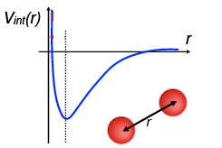
Interactions in a BEC
Low temperature, low energy
⇒ mainly 2-body elastic collisions!
Short range: ~ 1/r⁶
Typical interaction: van der Waals
Usually isotropic (spherically symmetric
electronic states) ⇒ s-wave (L = 0) collisions
Dilute system
Interaction range b << mean interparticle distance ⟨r⟩ ~ 𝜆_{dB}
⇒ Atoms feel a quantum average of Vint(r)
Interaction potential can be approximated by a contact pseudopotential:

Slide 17
Interactions in a BEC
Low temperature, low energy
⇒ mainly 2-body elastic collisions!
Short range: ~ 1/r⁶
Typical interaction: van der Waals
Usually isotropic (spherically symmetric
electronic states) ⇒ s-wave (L = 0) collisions
Dilute system
Interaction range b << mean interparticle distance ⟨r⟩ ~ 𝜆_{dB}
⇒ Atoms feel a quantum average of Vint(r)
Interaction potential can be approximated by a contact pseudopotential:
Contact interactions are parametrized by a unique important scalar quantity:
s-wave scattering length ≡ 𝑎_{s}

Slide 18
Superfluid ⁴He and BECs
SF ⁴He
BECs
Dense and strongly interacting liquid
Dilute and weakly interacting gas
b ~ ⟨r⟩
b << ⟨r⟩
b = interaction range, ⟨r⟩ = mean interparticle distance

Slide 19
Superfluid ⁴He and BECs
SF ⁴He
BECs
Dense and strongly interacting liquid
Dilute and weakly interacting gas
b ~ ⟨r⟩
b << ⟨r⟩
b = interaction range, ⟨r⟩ = mean interparticle distance
Deeply connected!
1938, London: The superfluid transition in ⁴He is a Bose-Einstein condensation!
-only based on the non-interacting BEC theory-
1956, Penrose & Onsager: extending Bogoliubov theory for weakly-interacting gaseous BECs to the case of strongly interacting fluids , they confirm London’s idea!

Slide 20
Superfluid ⁴He and BECs
SF ⁴He
BECs
Dense and strongly interacting liquid
Dilute and weakly interacting gas
b ~ ⟨r⟩
b << ⟨r⟩
b = interaction range, ⟨r⟩ = mean interparticle distance
Deeply connected!
1938, London: The superfluid transition in ⁴He is a Bose-Einstein condensation!
-only based on the non-interacting BEC theory-
1956, Penrose & Onsager: extending Bogoliubov theory for weakly-interacting gaseous BECs to the case of strongly interacting fluids , they confirm London’s idea!

Slide 21
Superfluid ⁴He and BECs
SF ⁴He
BECs
Dense and strongly interacting liquid
Dilute and weakly interacting gas
b ~ ⟨r⟩
b << ⟨r⟩
b = interaction range, ⟨r⟩ = mean interparticle distance
Deeply connected!
1938, London: The superfluid transition in ⁴He is a Bose-Einstein condensation!
-only based on the non-interacting BEC theory-
1956, Penrose & Onsager: extending Bogoliubov theory for weakly-interacting gaseous BECs to the case of strongly interacting fluids , they confirm London’s idea!
Roton minimum in dilute quantum gases?

Slide 22
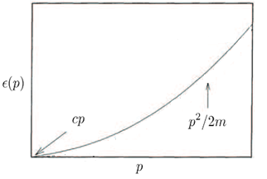
Contact interacting VS dipolar BECs – roton?
BECs with
only contact interactions:
No roton!
alkali atoms
Adapted from L. Pitaevskii and S. Stringari, Oxford University Press , vol. 164 (2016)

Slide 23
Contact interacting VS dipolar BECs – roton?
BECs with
only contact interactions:
No roton!
alkali atoms
Adapted from L. Pitaevskii and S. Stringari, Oxford University Press , vol. 164 (2016)
BECs with
contact + dipole-dipole interactions (DDI):
anisotropic
⇒ particles with non-zero dipole moment (electric/
magnetic)
Polar molecules
Rydberg atoms
Magnetic atoms
long-range

Slide 24
Contact interacting VS dipolar BECs – roton?
BECs with
only contact interactions:
No roton!
alkali atoms
Adapted from L. Pitaevskii and S. Stringari, Oxford University Press , vol. 164 (2016)
BECs with
contact + dipole-dipole interactions (DDI):
anisotropic
⇒ particles with non-zero dipole moment (electric/
magnetic)
Polar molecules
Rydberg atoms
Magnetic atoms
long-range
This talk!

Slide 25
Contact interacting VS dipolar BECs – roton?
BECs with
only contact interactions:
No roton!
alkali atoms
Adapted from L. Pitaevskii and S. Stringari, Oxford University Press , vol. 164 (2016)
BECs with
contact + dipole-dipole interactions (DDI):
anisotropic
⇒ particles with non-zero dipole moment (electric/
magnetic)
Polar molecules
Rydberg atoms
Magnetic atoms
Contact interactions dominate
long-range
Santos et al., PRL 90, (2003)
Theoretical proposal:
emergence of roton minimum in the excitation spectrum of weakly-interacting dipolar BECs!
Roton if DDI dominate
k l_{z}

Slide 26
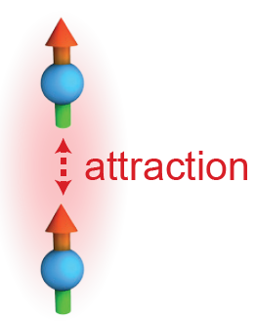
Theory of the roton mode in dipolar BECs
Santos et al., PRL 90, (2003)
Theoretical proposal: emergence of roton minimum in the excitation spectrum of weakly-interacting dipolar BECs
Requirements:
DDI

Slide 27
Theory of the roton mode in dipolar BECs
Santos et al., PRL 90, (2003)
Theoretical proposal: emergence of roton minimum in the excitation spectrum of weakly-interacting dipolar BECs
Requirements:
DDI
Trapped dipolar BEC with strong confinement along the direction of the dipoles

Slide 28
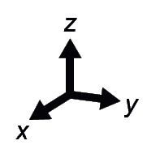
Theory of the roton mode in dipolar BECs
Santos et al., PRL 90, (2003)
Theoretical proposal: emergence of roton minimum in the excitation spectrum of weakly-interacting dipolar BECs
Requirements:
DDI
Trapped dipolar BEC with strong confinement along the direction of the dipoles
$$l_{z}$$
$$l_{z}=\sqrt{\frac{ℏ}{mω_{z}}}$$
harmonic oscillator length along z-axis
$$ω_{z}$$
= trapping frequency along $z$

Slide 29
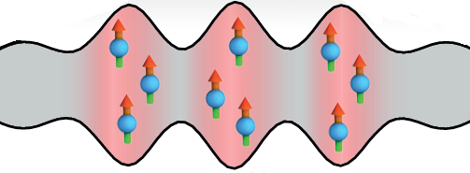
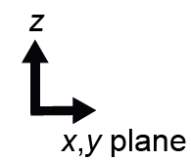
Theory of the roton mode in dipolar BECs
Santos et al., PRL 90, (2003)
Theoretical proposal: emergence of roton minimum in the excitation spectrum of weakly-interacting dipolar BECs
Requirements:
DDI
Trapped dipolar BEC with strong confinement along the direction of the dipoles
Contact interactions dominate
$$l_{z}$$
DDI dominate
$$l_{z}=\sqrt{\frac{ℏ}{mω_{z}}}$$
$$kl_{z}<1$$
k l_{z}
$$kl_{z}≳1$$
harmonic oscillator length along z-axis
$$l_{z}$$
$$λ=2π/k>l_{z}$$
$$λ=2π/k \sim l_{z}$$
$$ω_{z}$$
= trapping frequency along $z$
Dominantly repulsive DDI
Dominantly attractive DDI

Slide 30
Theory of the roton mode in dipolar BECs
Santos et al., PRL 90, (2003)
Theoretical proposal: emergence of roton minimum in the excitation spectrum of weakly-interacting dipolar BECs
Requirements:
DDI
Trapped dipolar BEC with strong confinement along the direction of the dipoles
Contact interactions dominate
$$l_{z}$$
$$k_{roton}\sim \frac{1}{l_{z}}$$
DDI dominate
$$l_{z}=\sqrt{\frac{ℏ}{mω_{z}}}$$
$$kl_{z}<1$$
k l_{z}
$$kl_{z}≳1$$
harmonic oscillator length along z-axis
$$l_{z}$$
$$λ=2π/k>l_{z}$$
$$λ=2π/k \sim l_{z}$$
$$ω_{z}$$
= trapping frequency along $z$
Dominantly repulsive DDI
Dominantly attractive DDI

Slide 31
Theory of the roton mode in dipolar BECs
Santos et al., PRL 90, (2003)
Theoretical proposal: emergence of roton minimum in the excitation spectrum of weakly-interacting dipolar BECs
Requirements:
DDI
Experimental observation of the roton mode in a dipolar BEC was still missing…
Trapped dipolar BEC with strong confinement along the direction of the dipoles
Contact interactions dominate
$$l_{z}$$
$$k_{roton}\sim \frac{1}{l_{z}}$$
DDI dominate
$$l_{z}=\sqrt{\frac{ℏ}{mω_{z}}}$$
$$kl_{z}<1$$
k l_{z}
$$kl_{z}≳1$$
harmonic oscillator length along z-axis
$$l_{z}$$
$$λ=2π/k>l_{z}$$
$$λ=2π/k \sim l_{z}$$
$$ω_{z}$$
= trapping frequency along $z$
Dominantly repulsive DDI
Dominantly attractive DDI

Slide 32
Observation of the roton mode excitation in a dipolar
Bose-Einstein condensate of Erbium atoms

Slide 33
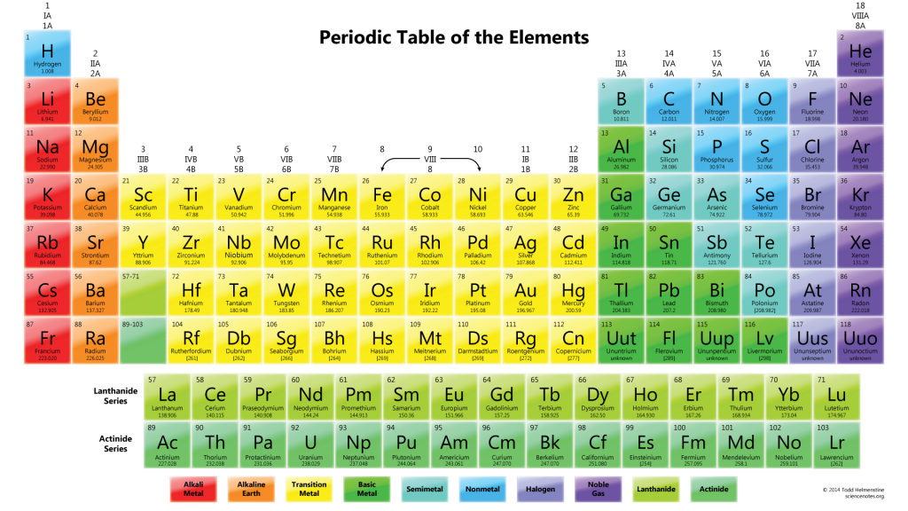
Erbium (Er) – a strongly magnetic species
Electron configuration: [Xe]4f¹²6s²
→ submerged f-shell with ³H₆ electronic ground state (L = 5, S = 1, J = 6)
High magnetic moment $μ_{Er}=7{ μ}_{B}$
Cf. for alkali atoms: $μ=1 μ_{B}$
Cf. for alkali atoms: S state (L = 0)

Slide 34
Erbium (Er) – a strongly magnetic species
$$μ_{Cr}=6 μ_{B}$$
$$μ_{Dy}=10 μ_{B}$$
Electron configuration: [Xe]4f¹²6s²
→ submerged f-shell with ³H₆ electronic ground state (L = 5, S = 1, J = 6)
High magnetic moment $μ_{Er}=7{ μ}_{B}$
Cf. for alkali atoms: $μ=1 μ_{B}$
Cf. for alkali atoms: S state (L = 0)

Slide 35
The Er experiment in Innsbruck - toolbox
The system
¹⁶⁶Er
BEC of typically 90,000 atoms with ~ 65 % of atoms in the condensate
Elongated (cigar-shaped) trap with frequencies
$$ν_{z}≳ν_{x}≫ν_{y}$$

Slide 36
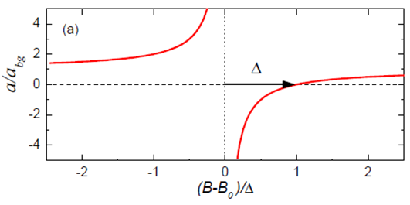
The Er experiment in Innsbruck - toolbox
The system
Control of interactions
¹⁶⁶Er
Contact interactions
BEC of typically 90,000 atoms with ~ 65 % of atoms in the condensate
Parametrized by the
s-wave scattering length $a_{s}$
⇒ TUNABLE via Feshbach resonances
Elongated (cigar-shaped) trap with frequencies
$$ν_{z}≳ν_{x}≫ν_{y}$$
DDI ⇒ TUNABLE via external magnetic field
B_{ext} controls 𝛳
Notes:
Metti: at this low T the only contact interactions are s-wave elastic collisions -> the only important parameter is a_s → IMP! In ultracold atomic system a_s can be easily tuned by means of Feshbach resonances!! Metti il grafico standard con la formula di a_s (B)
(Dipolar interactions can be tuned by changing the orientation of B external, exploiting their anysotropic character)
Two fundamental lenght scales: a_s and a_dd → epsilon_dd. Tuning a-s means tuning the relative strenght of contact and DDI! → This we use to go into the dipole dominated regime, where we expect a roton!!!
NB: il grafico con la nostra a_sVSb conversion mettilo dopo quando spieghi la exp sequence e fai vedere a che a_s si fa la BEC con poi la freccia verso a_s piu‘ basse! → vedi ppt Dani!

Slide 37
The Er experiment in Innsbruck - toolbox
The system
Control of interactions
¹⁶⁶Er
Contact interactions
BEC of typically 90,000 atoms with ~ 65 % of atoms in the condensate
Parametrized by the
s-wave scattering length $a_{s}$
⇒ TUNABLE via Feshbach resonances
Elongated (cigar-shaped) trap with frequencies
$$ν_{z}≳ν_{x}≫ν_{y}$$
DDI ⇒ TUNABLE via external magnetic field
dipolar length
Notes:
Metti: at this low T the only contact interactions are s-wave elastic collisions -> the only important parameter is a_s → IMP! In ultracold atomic system a_s can be easily tuned by means of Feshbach resonances!! Metti il grafico standard con la formula di a_s (B)
(Dipolar interactions can be tuned by changing the orientation of B external, exploiting their anysotropic character)
Two fundamental lenght scales: a_s and a_dd → epsilon_dd. Tuning a-s means tuning the relative strenght of contact and DDI! → This we use to go into the dipole dominated regime, where we expect a roton!!!
NB: il grafico con la nostra a_sVSb conversion mettilo dopo quando spieghi la exp sequence e fai vedere a che a_s si fa la BEC con poi la freccia verso a_s piu‘ basse! → vedi ppt Dani!

Slide 38
The Er experiment in Innsbruck - toolbox
The system
Control of interactions
¹⁶⁶Er
Contact interactions
BEC of typically 90,000 atoms with ~ 65 % of atoms in the condensate
Parametrized by the
s-wave scattering length $a_{s}$
⇒ TUNABLE via Feshbach resonances
Elongated (cigar-shaped) trap with frequencies
$$ν_{z}≳ν_{x}≫ν_{y}$$
DDI ⇒ TUNABLE via external magnetic field
$$ε_{dd}=\frac{a_{dd}}{a_{s}}$$
dipolar length
Relative interaction strength
Notes:
Metti: at this low T the only contact interactions are s-wave elastic collisions -> the only important parameter is a_s → IMP! In ultracold atomic system a_s can be easily tuned by means of Feshbach resonances!! Metti il grafico standard con la formula di a_s (B)
(Dipolar interactions can be tuned by changing the orientation of B external, exploiting their anysotropic character)
Two fundamental lenght scales: a_s and a_dd → epsilon_dd. Tuning a-s means tuning the relative strenght of contact and DDI! → This we use to go into the dipole dominated regime, where we expect a roton!!!
NB: il grafico con la nostra a_sVSb conversion mettilo dopo quando spieghi la exp sequence e fai vedere a che a_s si fa la BEC con poi la freccia verso a_s piu‘ basse! → vedi ppt Dani!

Slide 39
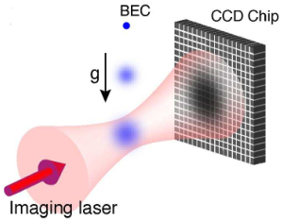
The Er experiment in Innsbruck - toolbox
The system
Control of interactions
¹⁶⁶Er
Contact interactions
BEC of typically 90,000 atoms with ~ 65 % of atoms in the condensate
Parametrized by the
s-wave scattering length $a_{s}$
⇒ TUNABLE via Feshbach resonances
Elongated (cigar-shaped) trap with frequencies
$$ν_{z}≳ν_{x}≫ν_{y}$$
Time-of-flight imaging
Absorption imaging of the freely expanding cloud
(after switching off the trap)
DDI ⇒ TUNABLE via external magnetic field
time
$$a_{dd}=\frac{μ_{0}μ^{2}m}{12πℏ^{2}}$$
$$ε_{dd}=\frac{a_{dd}}{a_{s}}$$
⇓
dipolar length
Relative interaction strength
Map the in-trap momentum distribution!
Notes:
Dire che si fa absorption imaging: imaging the shadow of the atoms on a CCD, shining with resonant light!
Si usa TOF imaging, so let the cloud expand for a certain time, because of the limited resolution of our imaging setup
IMPORTANT! TOF images map the momentum distribution in trap→ roton peaks should appear in TOF images if we excite that mode! → THIS IS IMPORTANT!!!
→NB: l‘immagine dell‘ imaging verticale sulla nube lo posso mettere nella slides in cui descrivo la sequenza sperimentale!

Slide 40
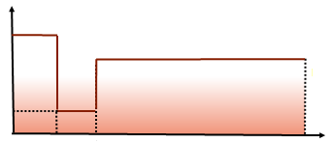
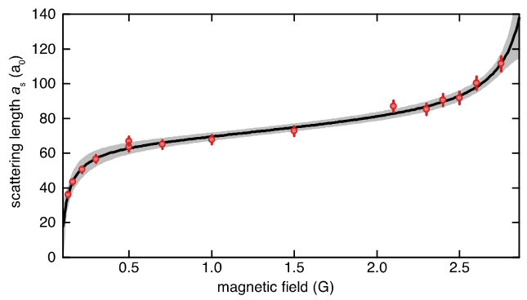
Experimental sequence
$a_{s}$(t)
Trap off
$a_{dd}$(¹⁶⁶Er) = 65.5 $a_{0}$
$$a_{s}^{in}=61 a_{0}$$
$$a_{s}^{fin}$$
time
holding time
in trap = 3-6 ms
time of flight = 30 ms
Measured $a_{s}$ vs B conversion between 0 and 3 Gauss
BEC

Slide 41
Experimental sequence
$a_{s}$(t)
Trap off
Imaging along dipoles
$a_{dd}$(¹⁶⁶Er) = 65.5 $a_{0}$
$$a_{s}^{in}=61 a_{0}$$
$$a_{s}^{img}=57 a_{0}$$
$$a_{s}^{fin}$$
time
holding time
in trap = 3-6 ms
time of flight = 30 ms
Measured $a_{s}$ vs B conversion between 0 and 3 Gauss
Imaging light
BEC
CCD

Slide 42
Experimental observations
For sufficiently low $a_{s}^{fin}< a_{dd}$
Emergence of peaks at finite momentum in time-of-flight images!

Slide 43
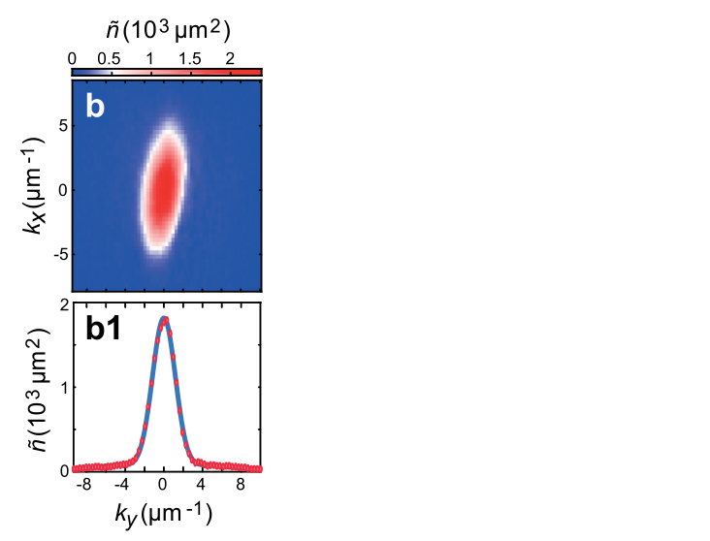
Experimental observations
For sufficiently low $a_{s}^{fin}< a_{dd}$
Emergence of peaks at finite momentum in time-of-flight images!
𝑎_{s}^{fin} = 54 𝑎₀
Average of ~ 20 images

Slide 44
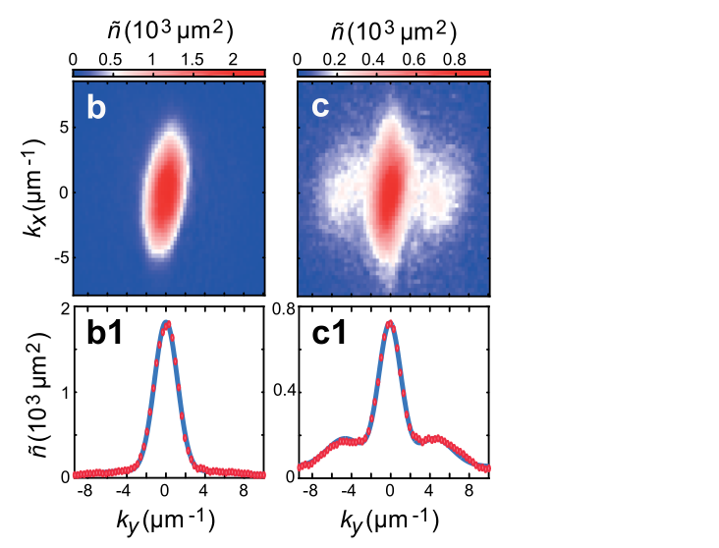
Experimental observations
For sufficiently low $a_{s}^{fin}< a_{dd}$
Emergence of peaks at finite momentum in time-of-flight images!
𝑎_{s}^{fin} = 54 𝑎₀
𝑎_{s}^{fin} = 44 𝑎₀
Average of ~ 20 images

Slide 45
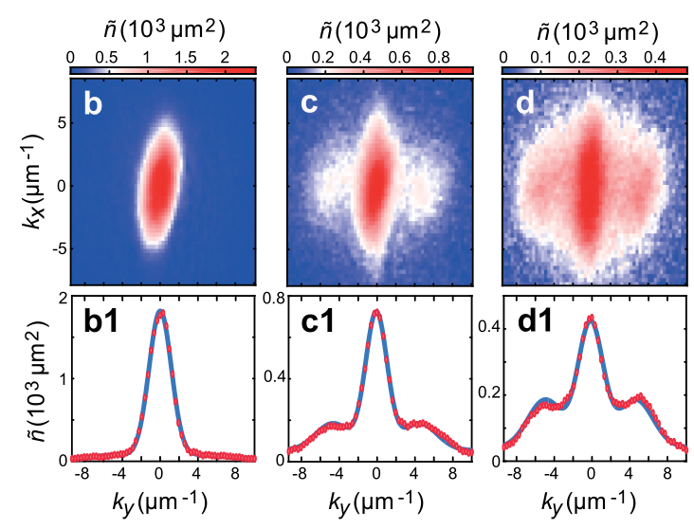
Experimental observations
For sufficiently low $a_{s}^{fin}< a_{dd}$
Emergence of peaks at finite momentum in time-of-flight images!
𝑎_{s}^{fin} = 54 𝑎₀
𝑎_{s}^{fin} = 44 𝑎₀
𝑎_{s}^{fin} = 37 𝑎₀
Average of ~ 20 images
Highly reproducible peaks!

Slide 46
Experimental observations
For sufficiently low $a_{s}^{fin}< a_{dd}$
Emergence of peaks at finite momentum in time-of-flight images!
𝑎_{s}^{fin} = 54 𝑎₀
𝑎_{s}^{fin} = 44 𝑎₀
𝑎_{s}^{fin} = 37 𝑎₀
Average of ~ 20 images
Highly reproducible peaks!
Are these peaks a signature of the population of the roton mode
in our system?

Slide 47
Look for linear scaling of k_{roton} with l_{z}⁻¹
Reminder!
Expected scaling from theory:
$$k_{roton}\sim \frac{1}{l_{z}}$$
$$l_{z}=\sqrt{\frac{ℏ}{mω_{z}}}$$

Slide 48
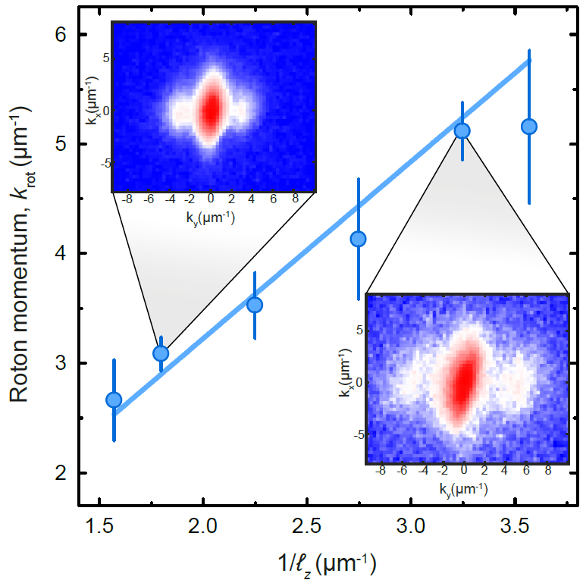
Look for linear scaling of k_{roton} with l_{z}⁻¹
Reminder!
Expected scaling from theory:
$$k_{roton}\sim \frac{1}{l_{z}}$$
$$l_{z}=\sqrt{\frac{ℏ}{mω_{z}}}$$
Increasing confinement along z-axis

Slide 49
Look for linear scaling of k_{roton} with l_{z}⁻¹
Reminder!
Expected scaling from theory:
$$k_{roton}\sim \frac{1}{l_{z}}$$
Linear fit:
$$k_{rot}l_{z}=1.61±0.04$$
Increasing confinement along z-axis

Slide 50
Comparison to theory
Quasi-1D analytical model for a axially elongated trap (infinite cigar-shaped trap)
For ${ ε}_{dd}=\frac{a_{dd}}{a_{s}}\sim 1$
the energy spectrum has a roton minimum
Roton momentum scales as $k_{rot}l_{z}=κ,$
where $κ= κ (ν_{z}/ν_{x})$

Slide 51
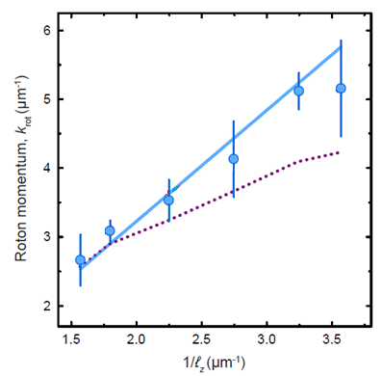
Comparison to theory
Quasi-1D analytical model for a axially elongated trap (infinite cigar-shaped trap)
For ${ ε}_{dd}=\frac{a_{dd}}{a_{s}}\sim 1$
the energy spectrum has a roton minimum
Roton momentum scales as $k_{rot}l_{z}=κ,$
where $κ= κ (ν_{z}/ν_{x})$
For our experimental parameters: $\frac{ν_{z}}{ν_{x}}≈1.6 ⇒ κ=1.59 ±0.15$
Linear fit of experimental data:
$$k_{rot}l_{z}=1.61±0.04$$
Quasi-1D
analytical model:
$$k_{rot}l_{z}=1.59±0.15$$

Slide 52
Comparison to theory
Quasi-1D analytical model for a axially elongated trap (infinite cigar-shaped trap)
For ${ ε}_{dd}=\frac{a_{dd}}{a_{s}}\sim 1$
the energy spectrum has a roton minimum
Roton momentum scales as $k_{rot}l_{z}=κ,$
where $κ= κ (ν_{z}/ν_{x})$
For our experimental parameters: $\frac{ν_{z}}{ν_{x}}≈1.6 ⇒ κ=1.59 ±0.15$
Numerical simulations
Real-time simulations reproducing the experimental conditions and ramp of $a_{s}$
Linear fit of experimental data:
$$k_{rot}l_{z}=1.61±0.04$$
Quasi-1D
analytical model:
$$k_{rot}l_{z}=1.59±0.15$$

Slide 53
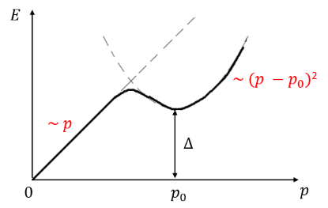
Conclusion
Roton: gapped elementary excitation corresponding to an energy minimum at finite momentum, emerging in the dispersion relation of superfluid ⁴He

Slide 54
Conclusion
Roton: gapped elementary excitation corresponding to an energy minimum at finite momentum, emerging in the dispersion relation of superfluid ⁴He
Roton minimum predicted to exist also in the energy spectrum of dipolar Bose-Einstein condensates, under the requirement of strong confinement along the dipoles
Santos et al., PRL 90, (2003)

Slide 55
Conclusion
Roton: gapped elementary excitation corresponding to an energy minimum at finite momentum, emerging in the dispersion relation of superfluid ⁴He
Roton minimum predicted to exist also in the energy spectrum of dipolar Bose-Einstein condensates, under the requirement of strong confinement along the dipoles
Santos et al., PRL 90, (2003)
The experiment: dipolar BEC of Er atoms in a axially elongated trap. Observation of peaks at finite momentum in time-of-flight images when entering the DDI-dominated regime.
⇒ Interpreted as a signature of
the roton mode excitation!

Slide 56
Conclusion
Roton: gapped elementary excitation corresponding to an energy minimum at finite momentum, emerging in the dispersion relation of superfluid ⁴He
Roton minimum predicted to exist also in the energy spectrum of dipolar Bose-Einstein condensates, under the requirement of strong confinement along the dipoles
Santos et al., PRL 90, (2003)
The experiment: dipolar BEC of Er atoms in a axially elongated trap. Observation of peaks at finite momentum in time-of-flight images when entering the DDI-dominated regime.
⇒ Interpreted as a signature of
the roton mode excitation!
Study of the scaling of the roton momentum with${ l}_{z}^{−1}$
⇒ Linear scaling verified!

Slide 57
Conclusion
Roton: gapped elementary excitation corresponding to an energy minimum at finite momentum, emerging in the dispersion relation of superfluid ⁴He
Roton minimum predicted to exist also in the energy spectrum of dipolar Bose-Einstein condensates, under the requirement of strong confinement along the dipoles
Santos et al., PRL 90, (2003)
The experiment: dipolar BEC of Er atoms in a axially elongated trap. Observation of peaks at finite momentum in time-of-flight images when entering the DDI-dominated regime.
⇒ Interpreted as a signature of
the roton mode excitation!
Study of the scaling of the roton momentum with${ l}_{z}^{−1}$
⇒ Linear scaling verified!
Comparison with theory: quasi 1D analytical model + numerical simulations
⇒ very good agreement!

Slide 58
Conclusion
Roton: gapped elementary excitation corresponding to an energy minimum at finite momentum, emerging in the dispersion relation of superfluid ⁴He
Roton minimum predicted to exist also in the energy spectrum of dipolar Bose-Einstein condensates, under the requirement of strong confinement along the dipoles
arXiv:1705.06914v1
Santos et al., PRL 90, (2003)
The experiment: dipolar BEC of Er atoms in a axially elongated trap. Observation of peaks at finite momentum in time-of-flight images when entering the DDI-dominated regime.
⇒ Interpreted as a signature of
the roton mode excitation!
Study of the scaling of the roton momentum with${ l}_{z}^{−1}$
⇒ Linear scaling verified!
Comparison with theory: quasi 1D analytical model + numerical simulations
⇒ very good agreement!

Slide 59
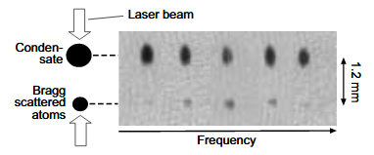
Outlooks
Access the low-energy excitation spectrum of our system using Bragg spectroscopy
(stimulated two-photon process)
Provides selectable momentum and energy transfer: it can be used to measure the roton gap!
Stenger et al., PRL 82 (1999)

Slide 60
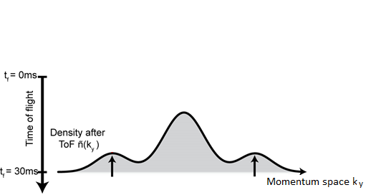
Outlooks
Access the low-energy excitation spectrum of our system using Bragg spectroscopy
(stimulated two-photon process)
Provides selectable momentum and energy transfer: it can be used to measure the roton gap!
Stenger et al., PRL 82 (1999)
Exploring the possibility of a supersolid phase in a dipolar BEC

Slide 61
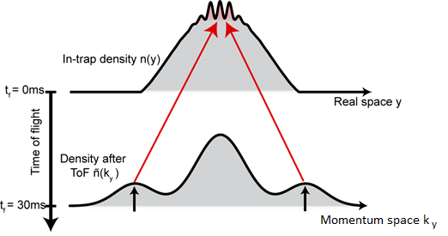
Outlooks
Access the low-energy excitation spectrum of our system using Bragg spectroscopy
(stimulated two-photon process)
Provides selectable momentum and energy transfer: it can be used to measure the roton gap!
Stenger et al., PRL 82 (1999)
Exploring the possibility of a supersolid phase in a dipolar BEC
Probe a in-trap density modulated ground state!

Slide 62
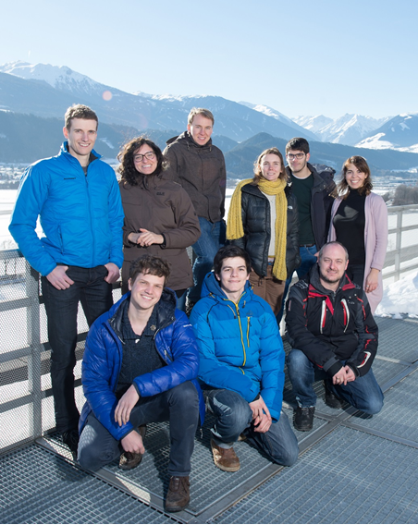
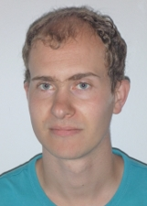
Thanks to…
The Erbium team
in Innsbruck
Theory collaborators from
Leibniz University of Hannover
Rick v. Bijnen
Jan H. Becher
GF
Lauriane Chomaz
Gabriele Natale
Francesca Ferlaino
Luis Santos
Falk Wächtler
Manfred J. Mark
Simon Baier
Daniel Petter

Slide 63
Thanks to…
The Erbium team
in Innsbruck
Theory collaborators from
Leibniz University of Hannover
Rick v. Bijnen
Jan H. Becher
GF
Lauriane Chomaz
Gabriele Natale
Francesca Ferlaino
Luis Santos
Falk Wächtler
…you for your attention!
Manfred J. Mark
Simon Baier
Daniel Petter

Slide 64
Experimental realization of a BEC – how to reach low T?
First step to ultracold: laser cooling
Red-detuned light
v
Radiation pressure
v
F
In average: F = <𝛿p/𝛿t> = - m v 𝛾
friction force!

Slide 65
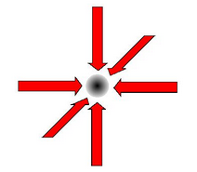
Experimental realization of a BEC – how to reach low T?
First step to ultracold: laser cooling
Red-detuned light
Typically in the lab: 3D optical molasses
v
Radiation pressure
T_{min} ~ 10 𝜇K
v
F
In average: F = <𝛿p/𝛿t> = - m v 𝛾
friction force!

Slide 66
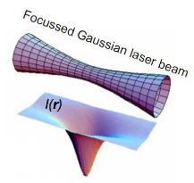
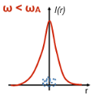
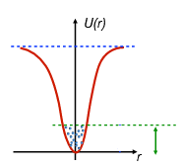
Experimental realization of a BEC – how to reach low T?
Optical trapping and evaporative cooling
Optical dipole trap: far-detuned laser beam focussed onto the atoms
Negligible absorption: no energy-transfer ⇒ conservative force!
U(r) ~ 1/(𝜔 - 𝜔_{A})*I(r)
I(r) = laser intensity
𝜔 = laser frequency
𝜔_{A} = atomic resonance frequency
Red-detuned optical dipole trap
U(r)
k_{B}T

Slide 67
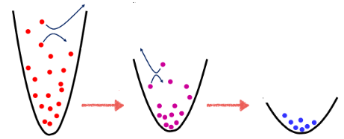
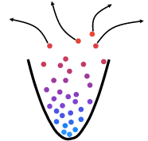
Experimental realization of a BEC – how to reach low T?
Optical trapping and evaporative cooling
Optical dipole trap: far-detuned laser beam focussed onto the atoms
Negligible absorption: no energy-transfer ⇒ conservative force!
U(r) ~ 1/(𝜔 - 𝜔_{A})*I(r)
I(r) = laser intensity
𝜔 = laser frequency
𝜔_{A} = atomic resonance frequency
Red-detuned optical dipole trap
U(r)
k_{B}T
Principle of evaporative cooling: the most energetic atoms escape from the trap. The remaining atoms thermalize at a lower T.
In the lab: forced evaporative cooling
Reduce I
Reduce I
T_{min} ~ 10 nK

Slide 68
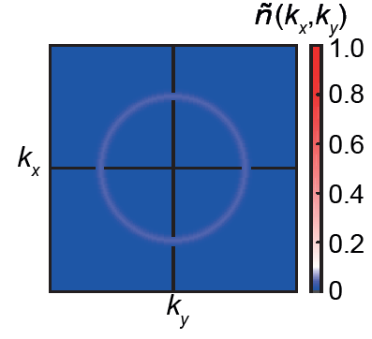
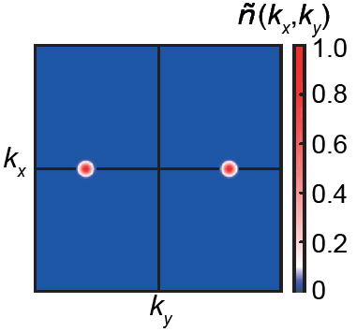
Roton signature in quasi-2D VS quasi-1D systems
Quasi-2D pancake geometry
Quasi-1D cigar-shaped geometry
Roton in-plane momentum distribution shows a ring
Roton in-plane momentum distribution shows two peaks

Slide 69
Roton signature in quasi-2D VS quasi-1D systems
Quasi-2D pancake geometry
Quasi-1D cigar-shaped geometry
Roton in-plane momentum distribution shows a ring
Roton in-plane momentum distribution shows two peaks
Enhanced experimental signal!

Slide 70
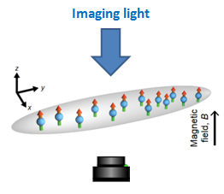
Mapping in-trap momentum distribution
Time-of-flight imaging along z-axis:
Probe the spatial density distribution in the (x,y) plane
$$n_{t_{TOF}}(x_{TOF}, y_{TOF},t_{TOF})$$
$$t_{TOF}=0 ms$$
⇒
In-trap spatial density distribution
⇒
$n_{t_{TOF}}\left(x_{TOF}, y_{TOF},t_{TOF}\right)=n (\frac{ℏk_{x}t_{TOF}}{m}$,$\frac{ℏk_{y}t_{TOF}}{m}, t_{TOF}) \sim \tilde{n} \left(k_{x},k_{y}\right)$
$$t_{TOF}>0$$

Slide 71
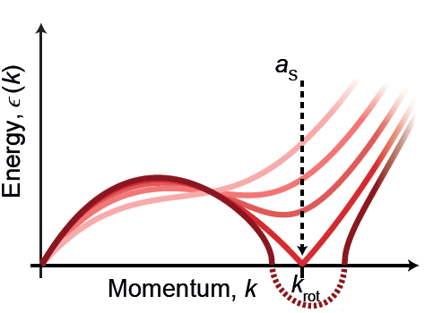
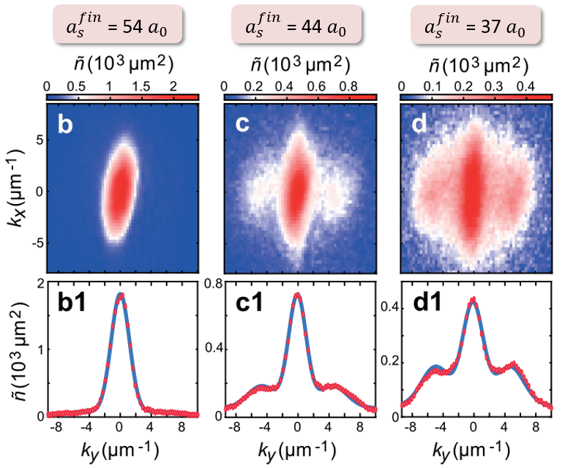
Increasing roton population with decreasing $a_{s}$
The roton gap 𝛥 decreases if $a_{s}$ is lowered
Relative amplitude of side peaks with respect to central peak
Critical scattering length$a_{s}^{∗}$

Slide 72
Increasing roton population with decreasing $a_{s}$
The roton gap 𝛥 decreases if $a_{s}$ is lowered
𝛥 = 0 ⇒ Roton instability
$ε (k)<$ 0 ⇒ unstable BEC
Relative amplitude of side peaks with respect to central peak
Critical scattering length$a_{s}^{∗}$

Slide 73
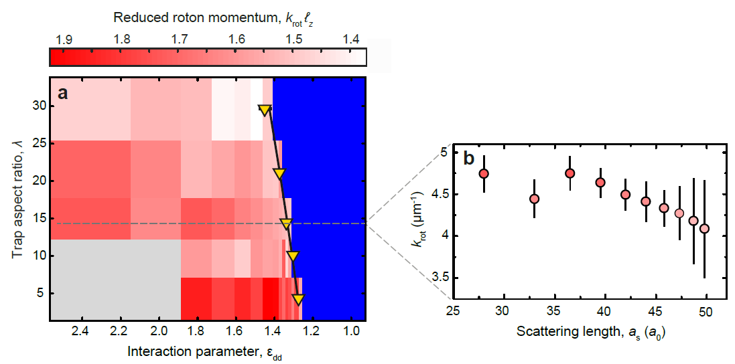
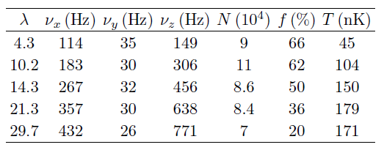
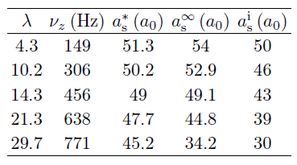
Critical $a_{s}$ for onset of roton population – vary $ν_{z}/ν_{y}$
Weak dependence of $k_{roton}$on $a_{s}$
Quasi-1D analytical model
Trap aspect ratio:
$$λ=ν_{z}/ν_{y}$$
Experimental data
Numerical simulations
Summary of all traps used in the experiment, with corresponding relevant parameters

Slide 74
Numerical simulations
Extended non-local Gross Pitaevskii equation (NLGPE):
Kinetic energy
External trap potential
Lee-Huang-Yang (LHY) correction
3-body losses
Mean-field interaction energy
Coupling constant for contact interactions
Contact interactions
DDI
Accounts for
quantum fluctuactions

Slide 75
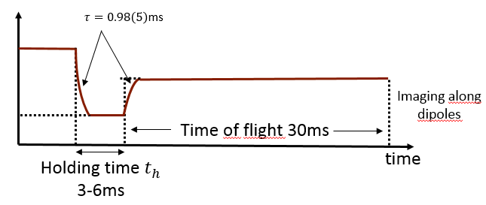
Numerical simulations
Extended non-local Gross Pitaevskii equation (NLGPE)
⇒ Real – time evolution simulations, including:
- Exact exponential ramp of the magnetic field:
$a_{s}$(t)
$$a_{s}^{in}=61 a_{0}$$
$$a_{s}^{img}=57 a_{0}$$
$$a_{s}^{fin}$$
- Finite temperature ⇒ thermal population of
harmonic trap eigenstates
- LHY correction
- Three-body losses ⇒ experimentally determined
loss parameter:
$L_{3}\sim {10}^{−41 }$m⁶s⁻¹

